Slide 1
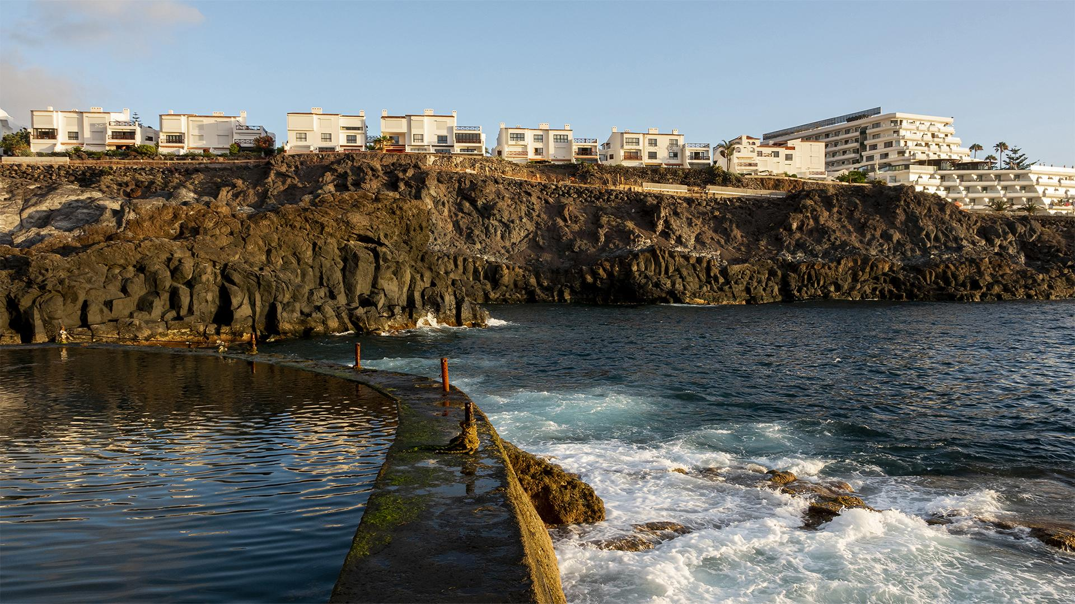
Hospitality Analysis
ATLIQ GRANDS REVENUE INSIGHTS
· FIVE STAR HOTELS·

Slide 2

TABLE OF CONTENTS
·01·
·02·
·03·
HOTEL CHAIN
Problem Statement
Tasks
Visualization
Analysis & Conclusion
·04·

Slide 3

HOTEL CHAIN
·01·
Problem Statement
This AtliQ Grands (Imaginary) owns multiple five-star hotels across India. They have been in the hospitality industry for the past 20 years. Due to strategic moves from other competitors and ineffective decision-making in management, AtliQ Grands are losing its market share and revenue in the luxury/business hotels category. As a strategic move, the managing director of AtliQ Grands wanted to incorporate “Business and Data Intelligence” to regain their market share and revenue. However, they do not have an in-house data analytics team to provide them with these insights.

Slide 4

·02·
HOTEL CHAIN
Tasks
Their revenue management team had decided to get these insights from their historicaldata.
SINCE 1930

Slide 5
HOTEL CHAIN
REQUIRED METRICS
SINCE 1930
REVENUE
OCCUPANCY %
REVPAR
Total Revenue Generated by AtliQ Grands
Total of all Percentage Occupancy by the AtliQ Grands Hotels
Revenue Per Available Rooms
DSRN
ADR
Realization %
Daily Sellable Room Nights
Average Daily Rate
It is a percentage of Utilized Room Nights by Booked Room Nights

Slide 6

·03·
VISUALIZATION
HOTEL CHAIN
The the Visualizations is done by using MS Power BI
SINCE 1930

Slide 7

·04·
ANALYSIS & CONCLUSION
HOTEL CHAIN
HOTEL CHAIN
SINCE 1930

Slide 8
LEVELS OF ANALYTICS
HOTEL CHAIN
LEVEL 1 METRICS
It tells you the uppermost area of the problems which are available or not.
LEVEL 2 METRICS
If the level 1 metric is causing any problem you dig even further to the know the problem which are related to the level 1.
LEVEL 3 METRICS and so on.
And again if level 2 is causing any issue you dig further down to know the exact cause of the problem.
SINCE 1930

Slide 9

HOTEL CHAIN
1,687,760,868
SINCE 1930
Total Number of Revenue generated by AtliQ Grands in 3 months.

Slide 10
HOTEL CHAIN
NUMBERS
57.8%
7,337
2,528
SINCE 1930
Occupancy %
RevPAR
DSRN
After making certain calculation the Occupancy % has been generated
7,337 is the Revenue Per Available Rooms
Daily Sellable Room Nights

Slide 11
HOTEL CHAIN
OTHER NUMBERS
12.7K
70.1%
3.62
SINCE 1930
ADR
Realization %
Average Rating
Average Daily Rate
Average of all given ratings
Utilized Room Nights by Booked Room Nights

Slide 12
Pricing Strategy
HOTEL CHAIN
·01·
·02·
·03·
FLAT PRICING
This is where the prices do not change and remain the same although when there is demand in the market.
WEEKDAY/WEEKEND PRICING
DYNAMIC PRICING
Here the Prices are set differently for Weekdays and Weekends.
Prices keep changing based on factors like Occupancy, or by keeping Price high on during peak days etc.
SINCE 1930

Slide 13
Analysis
HOTEL CHAIN
Due to the RevPar the Company has to follow some Pricing strategy
The Revpar under Weekdays/ends are different and it’s fluctuating
·01·
·03·
Weekdays/ends
Pricing Strategy
RevPAR
·02·
ADR
·04·
As we can see the RevPar is stable and not fluctuating when there is more demand.
Average Daily Rate is stable on both weekday/ends
SINCE 1930

Slide 14
KEY ACTIONS
HOTEL CHAIN
Pricing Strategy
Occupancy %
Price Elasticity
Adapting to Weekdays & Weekends Price Strategy will be more effective.
The ADR has to be reduced in order to increase Occupancy %
The Prices has to kept high when there is more demand and in Peak seasons
Online Booking Channels
Promotions
The Company and Hotels must keep an eye on the Customer Reviews and Ratings
The Hotels must promote their rooms through by giving exciting offers and Discount Coupons etc.
SINCE 1930

Slide 15

HOTEL CHAIN
CONCLUSION
SINCE 1930
This AtliQ Grands owns multiple five-star hotels across India.The hotel industry faces various challenges and opportunities in optimizing its revenue and profitability. One of the key factors that affects hotel performance is pricing strategy, which should be aligned with demand patterns, customer segments, competitive landscape, and market conditions. A common pricing strategy that many hotels adopt is to differentiate their room rates based on weekdays and weekends, as these periods may have different levels of demand and average daily rate (ADR).

Slide 16
HOTEL CHAIN
THANK YOU!
SINCE 1930
Gurunatha Hebbar
gurunatha.hebbara@gmail.com

